Slide 1
Performance Issues
Action hash bucket size with create/update
Unnecessary dumps

Slide 2
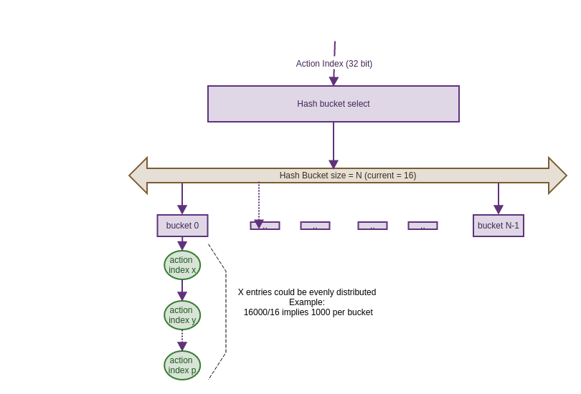
Action Create/Update Issues

Slide 3
Action Create/Update Issues

Slide 4
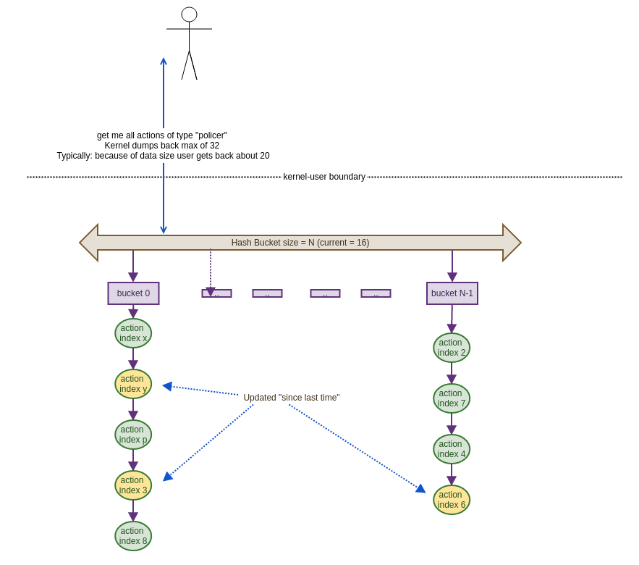
Action Dump Issues

Slide 5
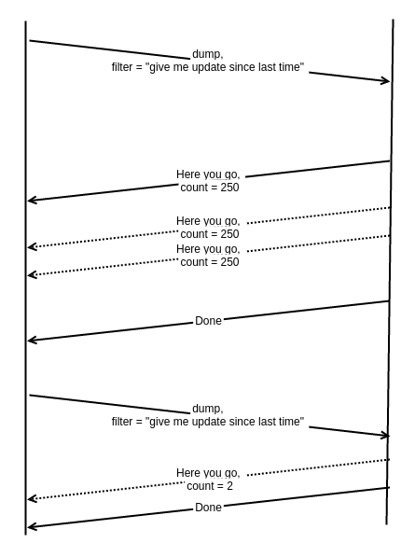
Action Dump Issues

Slide 6
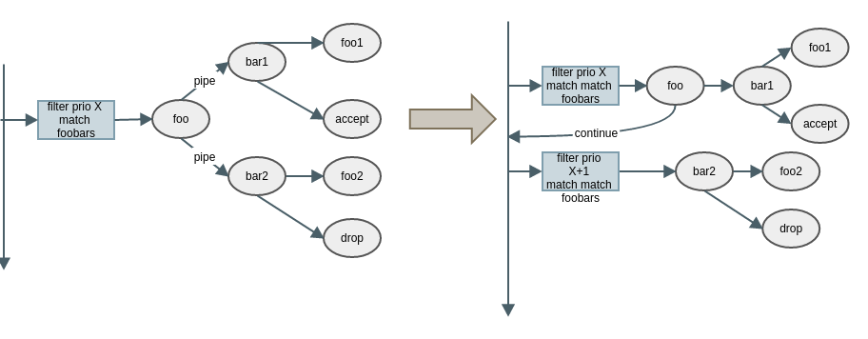
JumpX opcode

